Slide 1

Department of Computer Science and Engineering - Data Science
DECODING THE SOCIAL MEDIA LANDSCAPE: SENTIMENT, TRENDS, AND USER ENGAGEMENT ACROSS PLATFORMS
By
A.Sreeja. -21N81A6711
E.Bhargavi- 21N81A6727
G.Abhiroop - 21N81A6745
B.Mukesh- 22N85A6703
Under the Supervision of
Ms .G . Sushma, M.Tech
Assistant Professor

Slide 2
CONTENT
ABSTRACT
INTRODUCTION
LITERATURE SURVEY
PROBLEM STATEMENT
EXISTING SYSTEM
PROPOSED SYSTEM
METHODOLOGY
SYSTEM DESIGN
SYSTEM REQUIREMENTS
RESULT
FUTURE ENHANCEMENT
APPLICATIONS
CONCLUSION
REFERENCES

Slide 3
ABSTRACT
This project leverages social media data to analyze public opinion and engagement. It processes posts, likes, and retweets using machine learning to detect sentiment (positive, negative, neutral). Text data is transformed using TF-IDF, sentiment labels are encoded, and models like Random Forest and Gradient Boosting are trained and compared. Visualizations reveal how sentiment correlates with engagement, highlighting which content attracts more attention. A user-friendly interface enables trend analysis and model comparison, offering actionable insights to improve marketing strategies and audience connection.
Keywords: Social Media, Sentiment Analysis, Emotions, User Engagement, Natural Language Processing(NLP), TF-IDF, Gradient Boosting, Random Forest.

Slide 4
INTRODUCTION
In today’s digital era, social media platforms serve as a space where millions express opinions, shaping societal trends and public sentiment. This project utilizes machine learning to analyze large volumes of unstructured text data, focusing on sentiment analysis to decode emotional tones behind user posts. Supervised models like Random Forest and Gradient Boosting are applied for high-accuracy sentiment classification, using TF-IDF for text vectorization and label encoding for sentiment tagging. The system also integrates engagement metrics—likes, shares, retweets—to understand how sentiment drives user interaction. A dedicated visualization module presents sentiment distribution, platform-based trends, and emoji-driven emotions, offering a comprehensive pipeline from data ingestion to insightful analysis.

Slide 5
LITERATURE SURVEY
Research Paper – 1
Title: Twitter-Based Sentiment Analysis and Topic Modelling of Social Media Posts Using Natural Language Processing, to Understand People’s Perspectives Regarding COVID-19 Booster Vaccine Shots in India: Crucial to Expanding Vaccination Coverage
Authors: Praveen S.V., Jose Manuel Lorenz, Rajesh Ittamalla, Kuldeep Dhama, Daruri Venkata Srinivas Kumar, and Thivyaa Mohan
Published: Vaccines, 2022
Summary: This paper employs natural language processing techniques to analyze 76,979 English-language tweets from India regarding COVID-19 booster shots. The study uses sentiment analysis and Latent Dirichlet Allocation (LDA) for topic modeling to understand public opinion. Results show that 52.8% of tweets were negative, 31.5% neutral, and 15.6% positive, highlighting concerns over vaccine necessity, side effects, and mistrust in pharmaceutical companies.
Drawbacks: The analysis is limited to English tweets, which may exclude a significant portion of India’s population. Additionally, it does not incorporate demographic data or engagement metrics like retweets and likes, which could provide a deeper understanding of sentiment spread and influence.

Slide 6
Research Paper – 2
Title: Exploring Sentiment Analysis Techniques in Natural Language Processing: A Comprehensive Review
Authors: Karthick Prasad Gunasekaran
Published: College of Information and Computer Sciences, University of Massachusetts, Amherst, United States
Summary: This review paper provides an extensive overview of sentiment analysis techniques used in natural language processing, covering both traditional machine learning methods and modern deep learning approaches. It discusses various text representation techniques such as Bag of Words, TF-IDF, and word embeddings, and compares the performance of classifiers including Naive Bayes, SVM, LSTM, and BERT. The paper highlights the strengths and limitations of each method in different application contexts.
Drawbacks: The study is theoretical and lacks empirical evaluation on standardized datasets. It also does not explore real-time sentiment analysis or the integration of engagement metrics, which are increasingly relevant in social media applications.

Slide 7
Research Paper – 3
Title: Using Natural Language Processing to Explore Social Media Opinions on Food Security: Sentiment Analysis and Topic Modeling Study Authors: Annika Molenaar, Dickson Lukose, Linda Brennan, Eva L. Jenkins, and Tracy A. McCaffrey
Published: JMIR Infodemiology
Summary: This study applies natural language processing techniques, including sentiment analysis and topic modeling, to examine public opinions on food security as expressed on social media platforms. Using data collected from Twitter, the authors analyze user sentiment and identify key discussion topics related to food access, affordability, and government policy. The findings provide valuable insights into how the public perceives and discusses food security issues in real time Drawbacks: The study focuses primarily on English-language tweets, potentially excluding diverse perspectives. It also lacks real-time sentiment tracking and does not incorporate user engagement metrics such as likes or shares, which limits its depth in analyzing the spread and impact of opinions.

Slide 8

PROBLEM STATEMENT
There is a noticeable gap in having complete systems that can effectively combine machine learning with the analysis of social media sentiments and user engagement metrics like likes, shares, and retweets. Most existing tools focus only on one aspect—either basic sentiment analysis or simple engagement tracking. As a result, organizations struggle to make sense of the large volumes of unstructured data generated on platforms like Twitter, Facebook, or Instagram. Without a system that links sentiment with engagement, it's hard to understand how people truly feel about a topic or how much impact a post is making. This limits the ability of companies to respond quickly to public opinion, plan better marketing strategies, or improve customer engagement.

Slide 9
EXISTING SYSTEM
Existing sentiment analysis systems often rely on basic lexical methods or single classifiers, which struggle to capture the complexity of user behavior and platform-specific engagement patterns. One key limitation is the lack of integration with interaction metrics such as likes, retweets, and shares, which are critical for understanding the reach and influence of online content. These systems typically perform sentiment classification in isolation, failing to account for how emotions correlate with user engagement over time or across different platforms. Additionally, most tools offer limited support for analyzing variations between social media channels like Twitter, Facebook, or Instagram, reducing their ability to provide targeted insights.The absence of real-time analytics and interactive visualizations further hinders their usefulness in dynamic environments where trends evolve quickly. Moreover, these tools often lack the scalability and integration needed for seamless use in enterprise-level decision-making workflows.

Slide 10

PROPOSED SYSTEM
The proposed system is an advanced machine learning-based framework designed to analyze sentiment from social media data, while also incorporating engagement metrics such as likes and retweets to provide deeper insights. It includes comprehensive preprocessing steps like TF-IDF vectorization for text representation and label encoding for sentiment categorization, ensuring the data is structured and ready for model training. The system employs powerful ensemble learning techniques, specifically Gradient Boosting and Random Forest algorithms, to achieve high accuracy in sentiment classification. A user-friendly interface allows users to upload datasets, initiate preprocessing, and visualize the results through interactive graphs.

Slide 11
METHODOLOGY
1. Data Collection and Preprocessing:
Gather social media data using APIs (Twitter, Instagram).
Clean and preprocess text (tokenization, removal of special characters).
2. Model Selection and Training:
Train models like Random Forest, SVM, or Gradient Boosting.
Apply regularization and early stopping to avoid overfitting.
3. Backend Development:
Python, Flask, Pandas, scikit-learn, SQLite.
4. Integration of the Model:
Load trained models into the backend system.
Ensure real-time processing of user input and predictions.

Slide 12
5. Frontend Development:
Develop an interactive interface using Flask.
HTML, CSS, Java Script, Matplotlib-generated images
6. Security and Data Privacy:
Implement user authentication for secure access.
Anonymize data and adhere to platform usage guidelines.
7. Performance Evaluation:
Evaluate using metrics like accuracy, precision, and recall.
Use cross-validation for model reliability.
8. Deployment:
Optimize for real-time performance and scalability

Slide 13
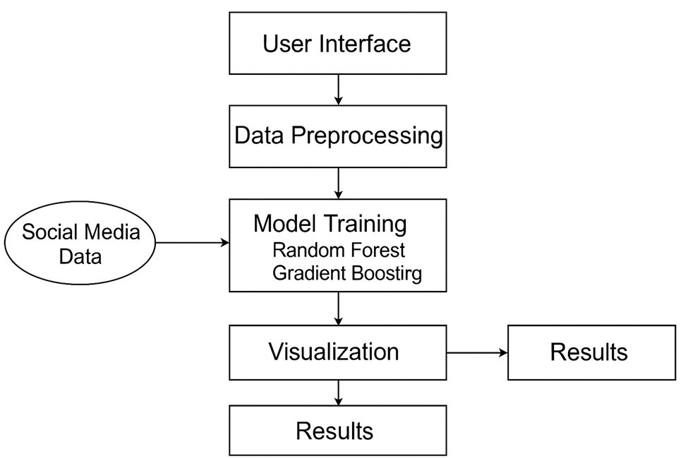
SYSTEM DESIGN

Slide 14
SYSTEM REQUIREMENTS
HARDWARE REQUIREMENTS:
. System : Pentium Dual Core.
. Hard Disk : 120 GB.
. Monitor : 15’’ LED
. Input Devices : Keyboard, Mouse
. Ram : 1 GB
SOFTWARE REQUIREMENTS:
. Operating system : Windows 11.
. Coding Language : python
. Tool : pycharm
. framework : flask
. Technologies : Machine Learning

Slide 15
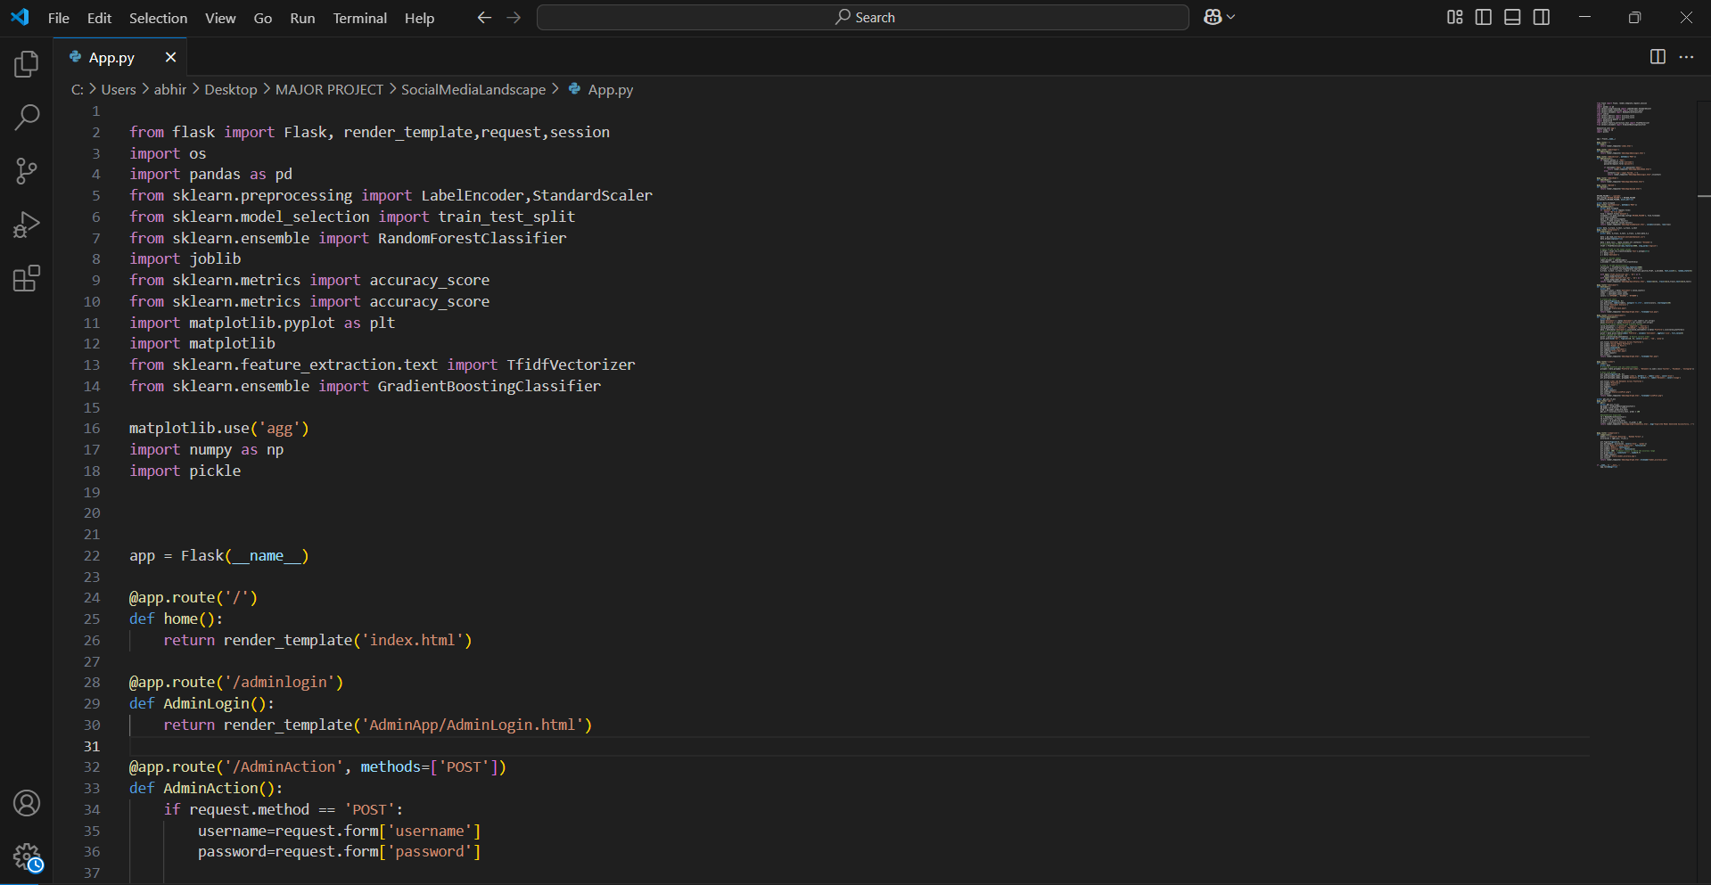
RESULT

Slide 16
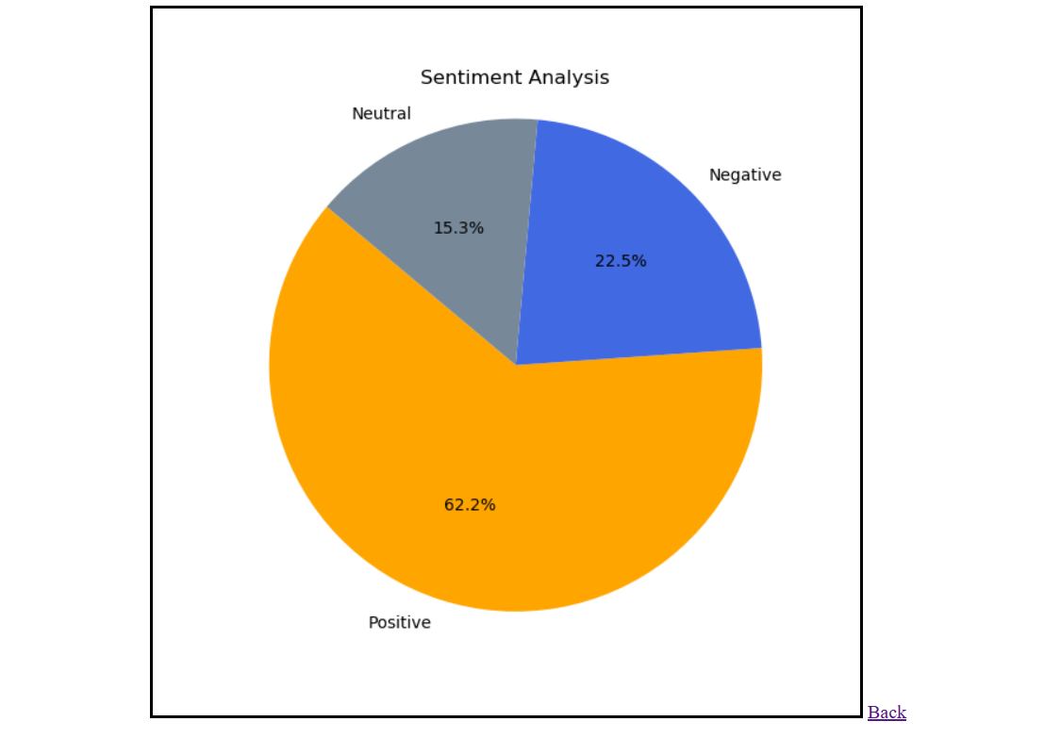

Slide 17
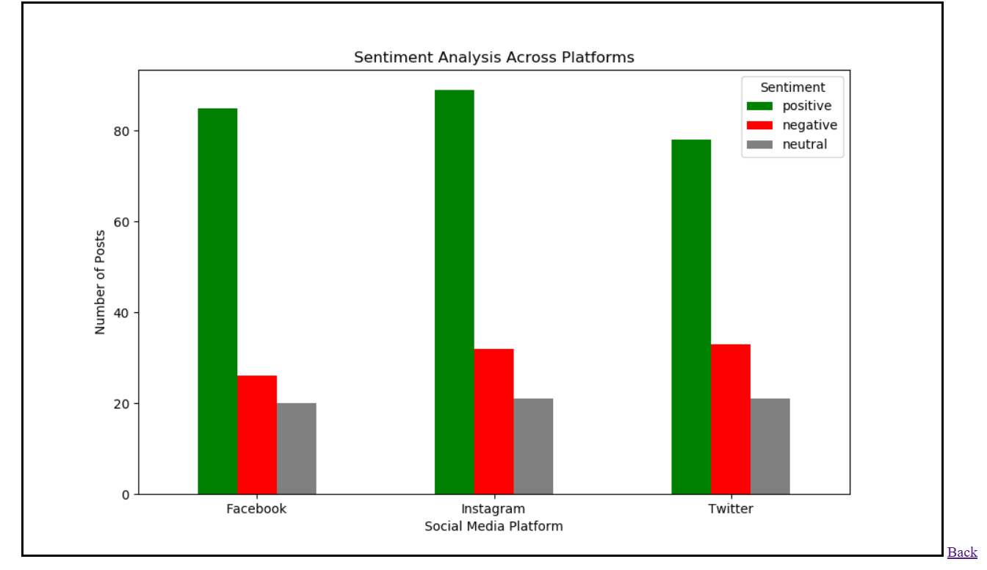

Slide 18
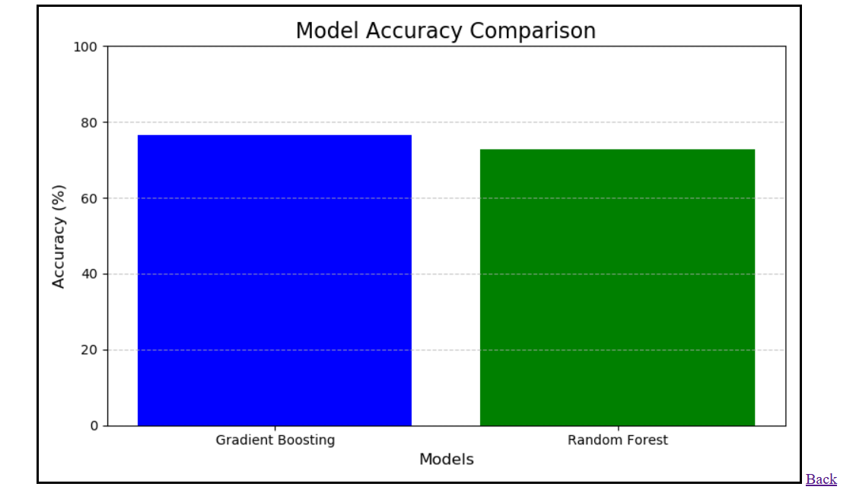

Slide 19
FUTURE ENHANCEMENT
Future enhancements can include deep learning models such as BERT or LSTM for improved sentiment understanding, real-time sentiment tracking, multilingual sentiment analysis, and integration with social media APIs for live data streaming. Additional modules could also be developed for topic modeling, influencer analysis, and emotion detection.

Slide 20
APPLICATIONS
- Businesses & brands: to understand customer opinion and market trends
- Influencers: to analyze what kind of posts get better reach and engagement
- Researchers: to study public sentiment on issues and events
- Marketing teams: to plan content based on audience mood and trends

Slide 21
CONCLUSION
This project demonstrates the effectiveness of machine learning in understanding and analyzing user sentiments and engagement on social media platforms. By integrating advanced preprocessing techniques and ensemble algorithms, the system offers accurate sentiment classification and insightful visualizations. The comparative analysis of models provides a clear understanding of performance metrics, enabling informed decision-making. The system’s modularity and scalability make it a robust tool for sentiment analysis in a variety of contexts.

Slide 22
REFERENCES
Sharma, R., & Das, A. (2023). "Sentiment Analysis on Twitter Data using Ensemble Learning." IEEE Access, vol. 11, pp. 45329–45337.
Liu, M., & Wang, Z. (2023). "A Comparative Study on Text Vectorization Methods for Sentiment Classification." IEEE Transactions on Knowledge and Data Engineering.
Verma, K., & Singh, D. (2024). "Hybrid Machine Learning Approach for Social Media Sentiment Analysis." IEEE Internet Computing.
Chen, X., & Huang, J. (2023). "Evaluating TF-IDF and Word Embeddings in Social Sentiment Analysis." IEEE Transactions on Computational Social Systems.
Narayanan, S., & Banerjee, S. (2024). "Real-Time Social Media Monitoring Using Ensemble Models." IEEE Systems Journal.

Slide 23
Any Queries?

Slide 24
THANK YOU

